Slide 1


Customer Segmentation and Behavior Analysis
Data Analyst Intern Task
Prepared by: Christine Gabriel

Slide 2
The goal of the customer segmentation analysis is to group customers based on their purchasing behaviors and spending score. By identifying distinct customer segments, businesses can tailor marketing strategies, improve customer targeting, and optimize product offerings to increase customer satisfaction and maximize profits.

Slide 3
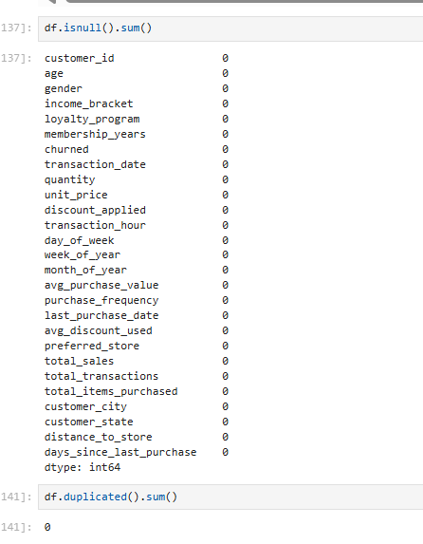
Data Cleaning
Checking missing values.
Checking duplicates.

Slide 4
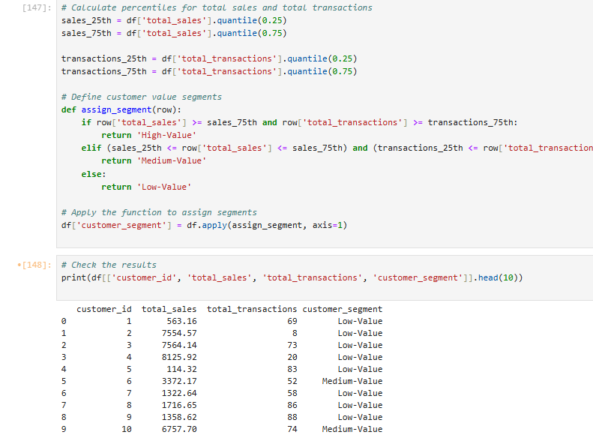
Modeling and Analysis
Quantile-Based Segmentation: Customers are divided into segments using quantiles of key attributes such as total sales and purchase frequency. highlighting distinct behavior patterns.
Why Quantile-Based Segmentation?: This method creates balanced segments based on customer behavior, allowing for targeted marketing and better decision-making.

Slide 5
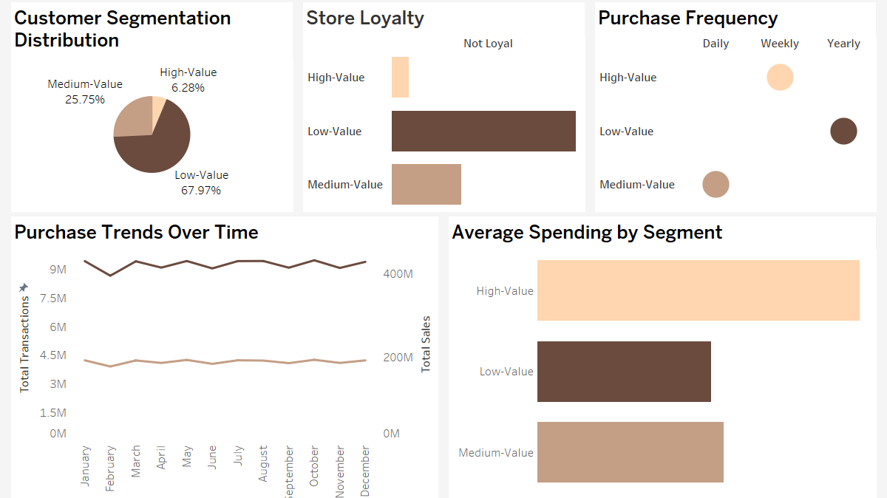
Dashboard

Slide 6
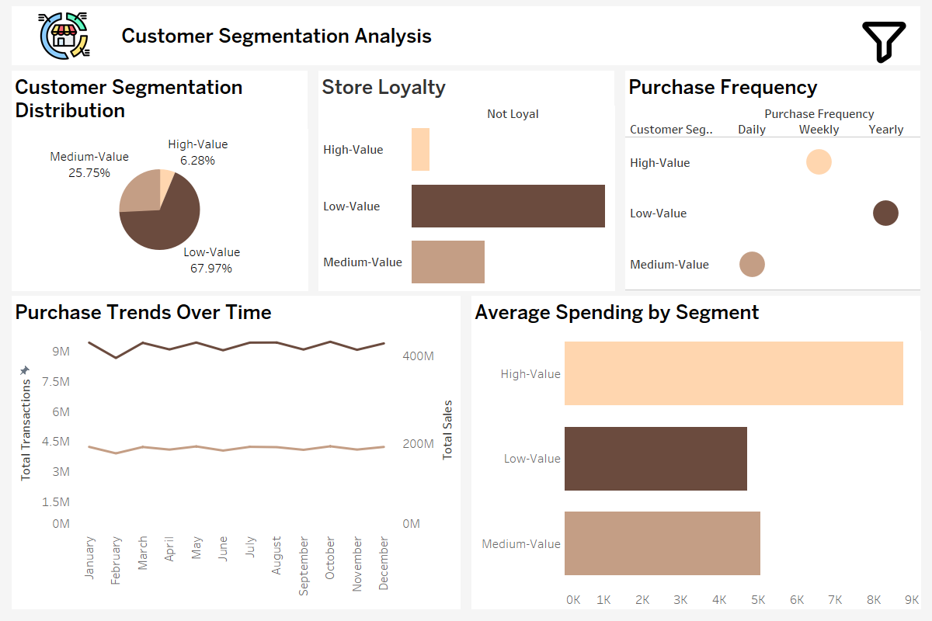
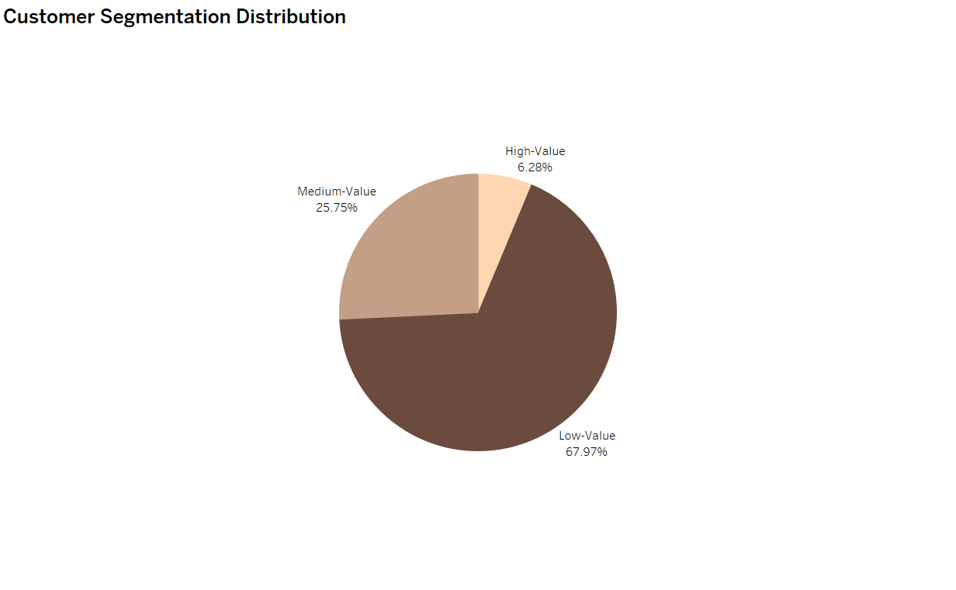
Customer Segmentation Distribution: Displays a pie chart dividing customers into three segments: Low-Value (67.97%) — the majority of customers fall into this category. Medium-Value (25.75%). High-Value (6.28%) — a small portion representing the most valuable customers.

Slide 7
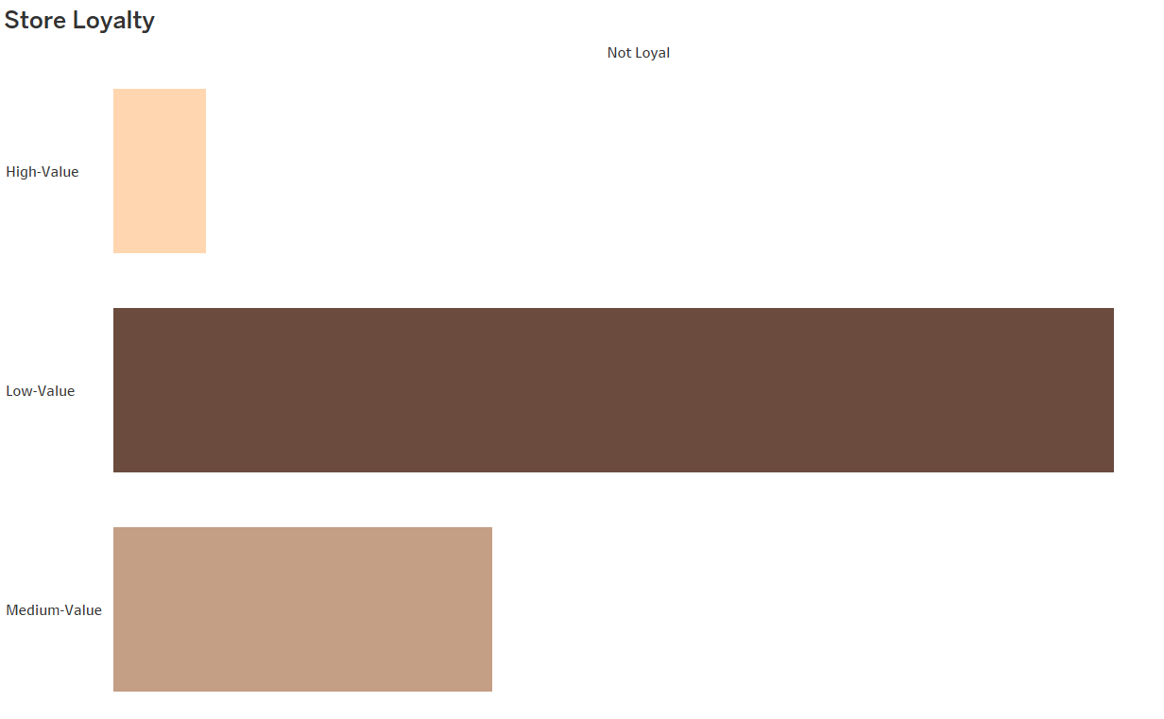
Store Loyalty: A bar chart depicting the proportion of Not Loyal customers for each segment: Low-Value customers dominate this category, contributing the largest share of Not Loyal customers. Medium-Value customers have moderate representation in the Not Loyal category. High-Value customers exhibit the lowest count in the Not Loyal category, reflecting a smaller tendency for disloyalty.

Slide 8
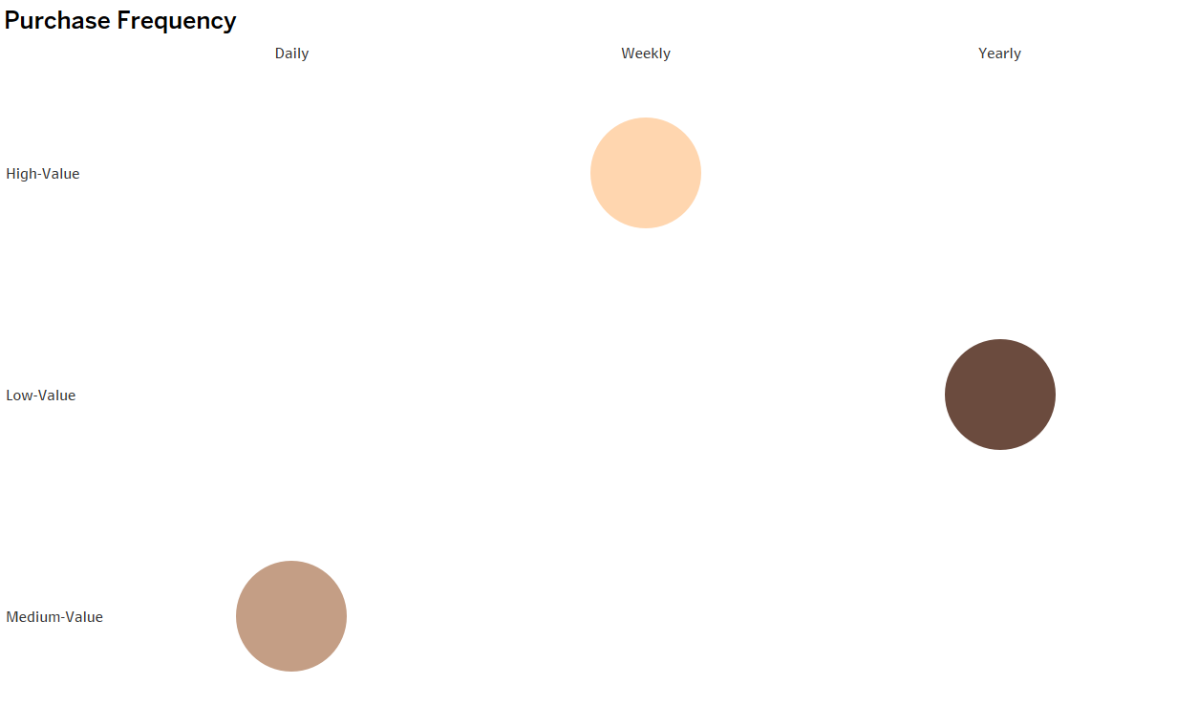
Purchase Frequency: A bubble chart showing how often customers in different segments (High-Value, Medium-Value, Low-Value) make purchases: High-Value: Purchase more frequently on a weekly basis. Medium-Value: Balanced frequency across all timeframes. Low-Value: Mostly make purchases on a yearly basis.

Slide 9
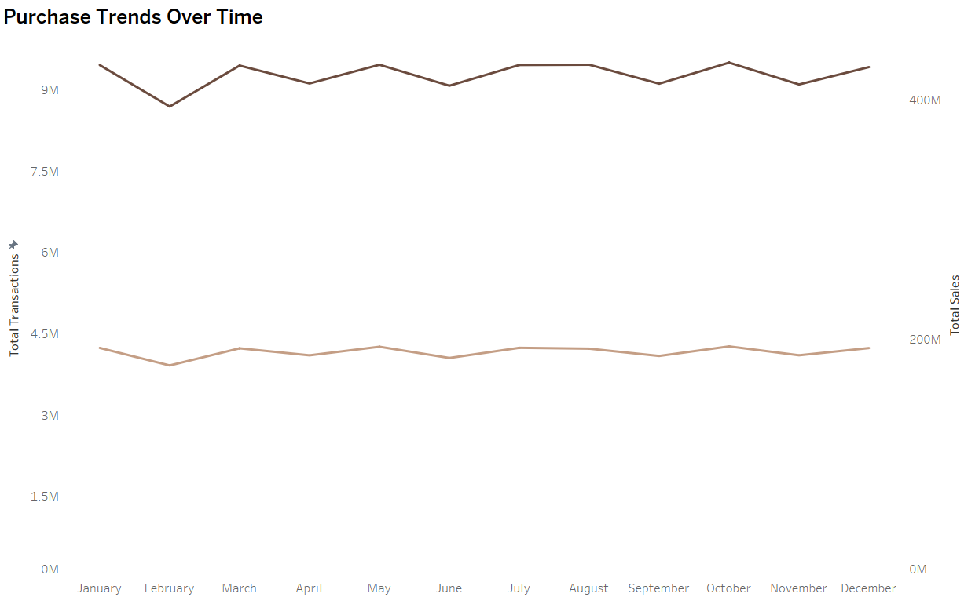
Purchase Trends Over Time: A line chart tracking: Total Transactions over the months of the year. Total Sales, allowing for trend analysis of revenue generation throughout the year.

Slide 10
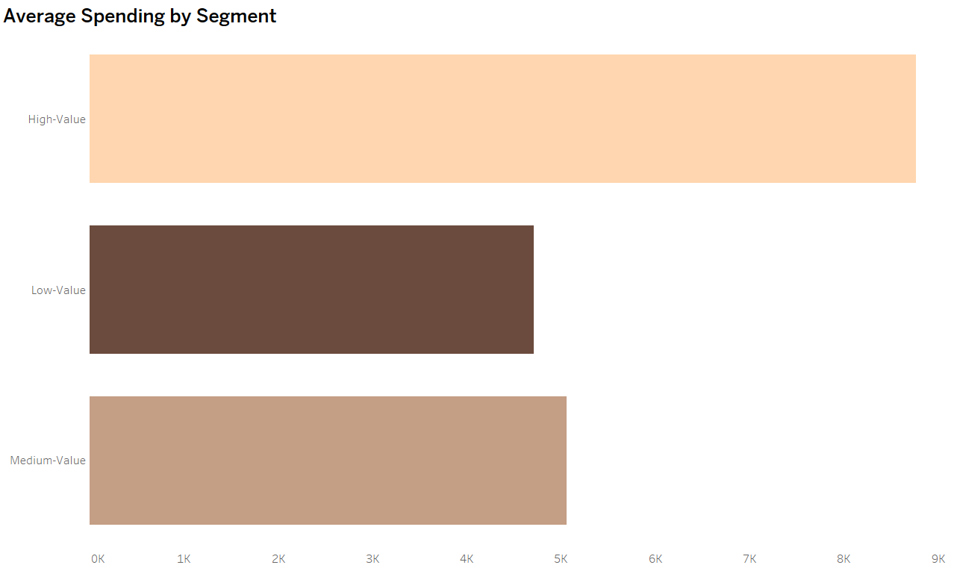
Average Spending by Segment: A horizontal bar chart showing average spending per customer segment: High-Value customers exhibit the highest average spending. Medium-Value and Low-Value customers have progressively lower spending averages.

Slide 11
1.Low-Value Customers : How can we make them buy more often or spend more? Strategy: Use discounts or special offers that expire within a month (e.g., “10% off your next purchase if made within 30 days”). 2. Medium-Value Customers: What will encourage them to move to the high-value category? Strategy: Provide incentives for spending above a certain threshold. For example, “Spend $300 this week and receive a $50 voucher.” 3. High-Value Customers : How can we increase their spending even further? Strategy: Create exclusive VIP programs with personalized experiences. Offer premium products and early access to sales to keep them engaged and encourage even higher spending.
Recommendations

Slide 12
Thank you for your attention! Do you have any questions about dashboard, insights, or recommendations?

